Slide 1


Financial Projection and Savings Probability Model: A 5-Year Simulation
Gaining a clear picture of one's financial future requires careful planning and the ability to model various scenarios. This report delves into a comprehensive financial projection and savings probability model, simulating the next 5 years of financial outcomes for an individual earning a monthly income of ₹50,000. By factoring in expenses, inflation, healthcare costs, and investment growth, this model aims to provide valuable insights into potential savings, investment outcomes, and overall financial well-being over the projected period.

Slide 2

Introduction
This report aims to assess the financial future of an individual earning a monthly income of ₹50,000 over a 5-year period. By considering factors like expenses, inflation, healthcare costs, and investment growth, this report provides a projection of potential savings and investment outcomes.
The scope encompasses a 5-year projection period, considering a fixed monthly income of ₹50,000. The report explores various spending patterns and investment scenarios, taking into account potential market fluctuations and economic uncertainties to offer a realistic outlook on future finances.

Slide 3

Methodology
1
2
3
Data Collection
Assumptions
Tools and Technology
Gather 12 months of spending data to analyze spending habits. This data is used as a baseline for projecting future expenses, adjusted for inflation.
Establish key assumptions: fixed monthly income (₹50,000), healthcare cost (10% of income), annual inflation rate (5%), and investment growth rate (8%). These assumptions form the basis for calculations.
Utilize Python programming language along with libraries like NumPy for numerical computations and Matplotlib for data visualization to build, simulate, and visualize the model.

Slide 4

Deterministic Savings Model
The deterministic savings model projects savings and investment growth using fixed rates for inflation (5%) and investment return (8%). This model calculates the future value of savings by considering annual income, expenses adjusted for inflation, and the compounding effect of fixed investment returns.
A detailed breakdown of annual savings, healthcare costs, and investment values provides a clear picture of how these components evolve over the 5-year period. This analysis helps understand the impact of fixed rates on the growth trajectory of savings and investments.

Slide 5

Probabilistic Savings Model Using Monte Carlo Simulation
The probabilistic savings model employs Monte Carlo simulation to introduce variability in inflation, spending, and investment growth rates. By running 1,000 simulations, this model accounts for the inherent uncertainty in these factors, providing a more realistic range of potential outcomes.
Each simulation generates a unique path for savings and investment growth based on randomly sampled values for inflation, spending, and investment returns within defined ranges. This approach provides a distribution of potential outcomes, highlighting the range of possibilities and their associated probabilities.

Slide 6
Data Visualization
Visualizing the results of both the deterministic and probabilistic models provides a more intuitive understanding of the projected financial outcomes. Bar graphs effectively illustrate the growth of savings and investments under different scenarios.
Deterministic Model Graph
Probabilistic Model Graph
A bar graph illustrating the deterministic model presents a clear upward trend in savings and investment values due to the fixed rates. This visualization emphasizes the impact of consistent growth and compounding over time.
In contrast, the probabilistic model graph exhibits variations in bar heights, reflecting the fluctuating inflation, spending, and investment returns. This visualization underscores the inherent uncertainty in real-world financial projections.

Slide 7

Future Financial Goals Based on Savings
After 5 years, the projected investment value significantly differs between the deterministic and probabilistic models. The deterministic model, with its fixed parameters, offers a point estimate of potential savings. The probabilistic model, considering a range of possibilities, provides a more comprehensive view, presenting the likelihood of achieving different savings levels.
These projected savings can be evaluated against potential future purchases, such as a car, motorbike, or a down payment for a home. By comparing the projected savings with the estimated costs of these goals, individuals can assess the feasibility of achieving them within the given timeframe.

Slide 8
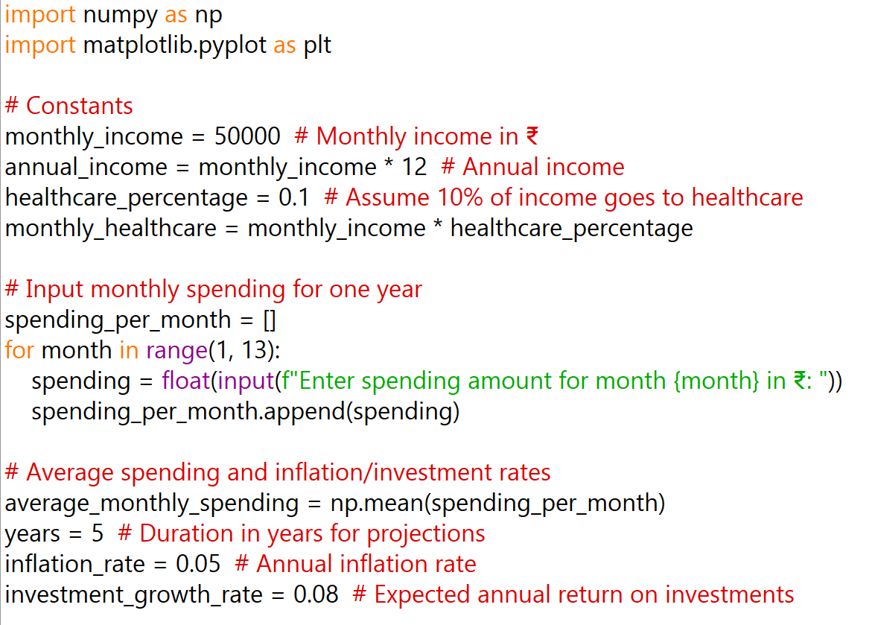

CODE WHICH IS IMPLEMENTED IS

Slide 9
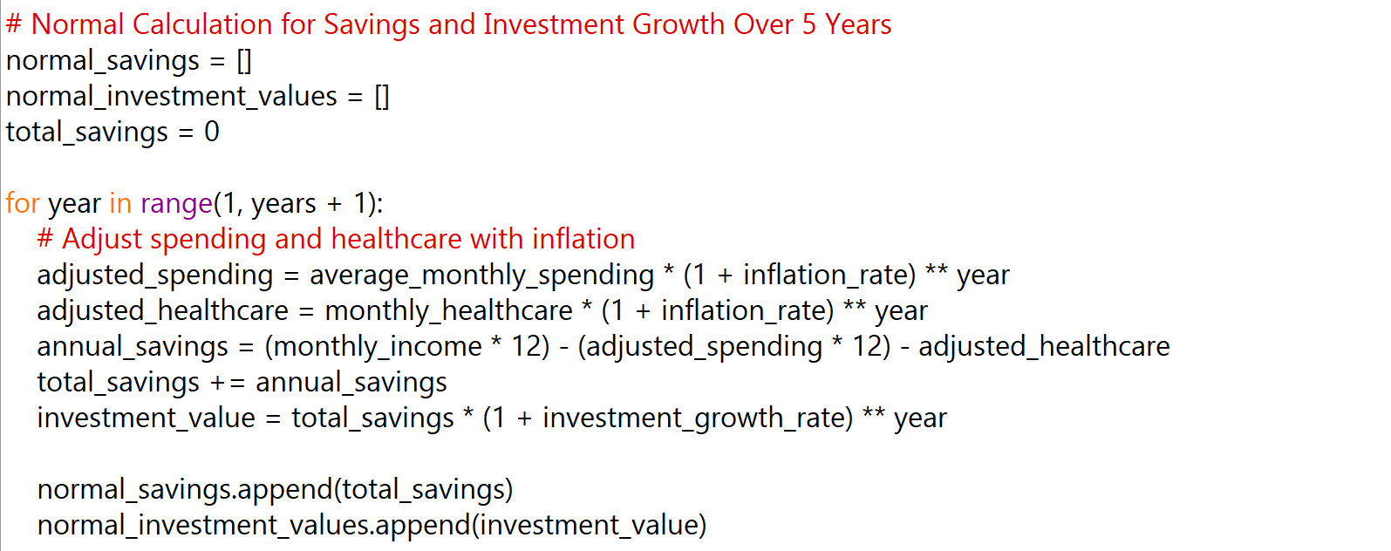

Slide 10
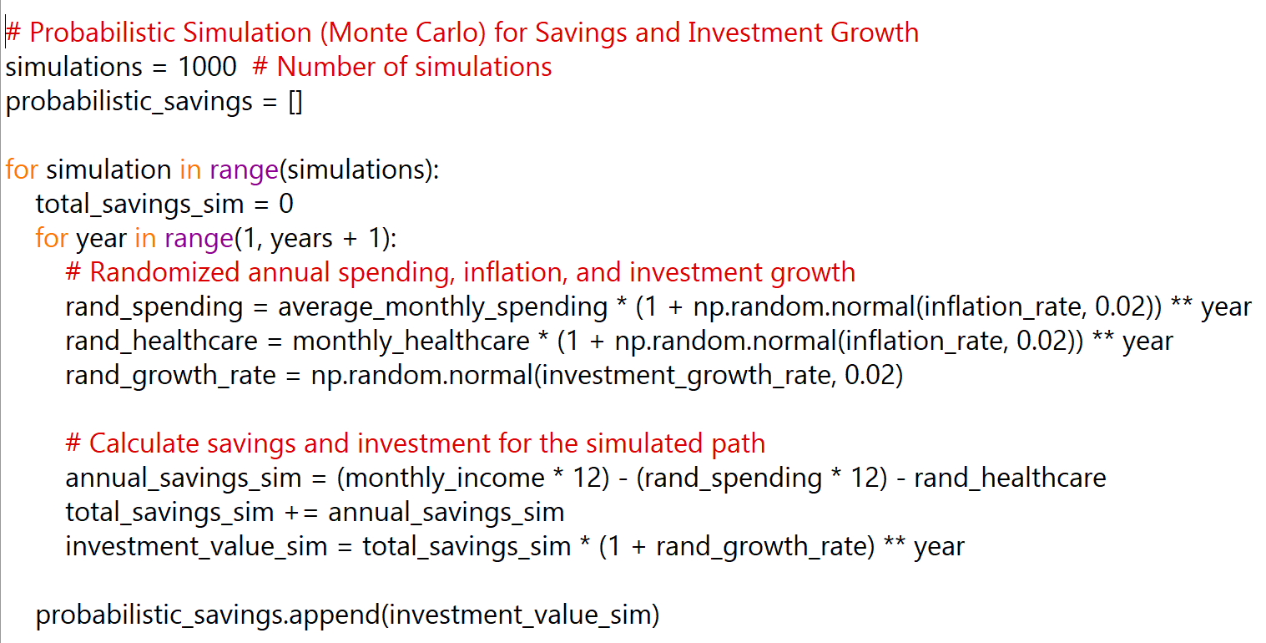

Slide 11
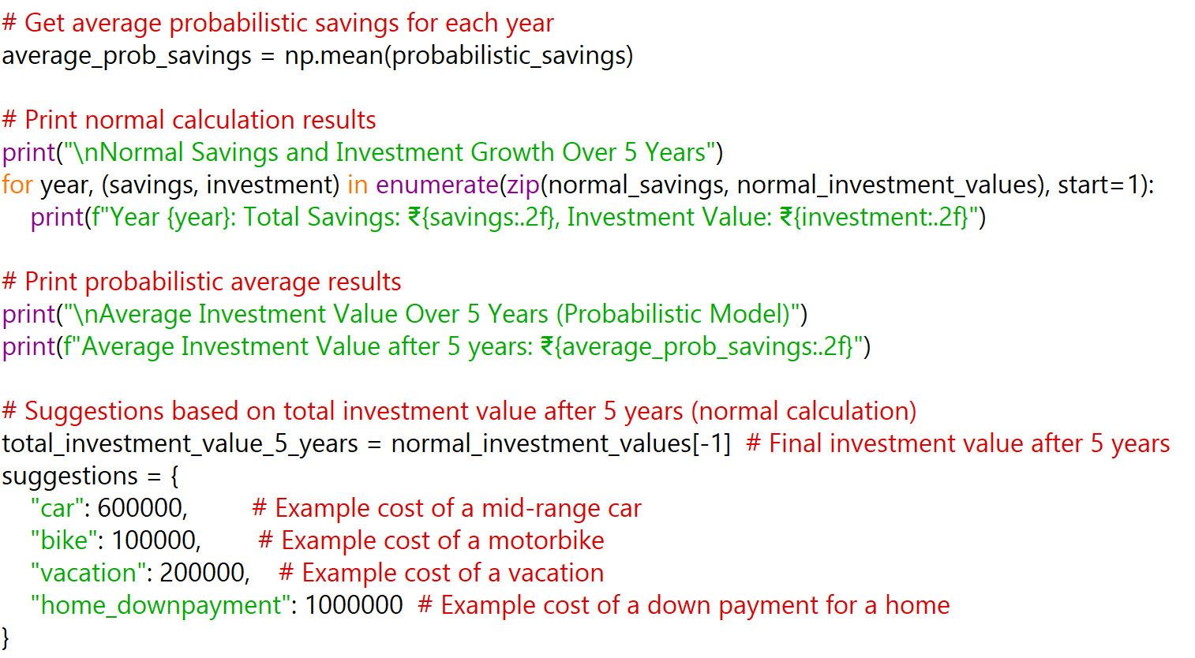

Slide 12
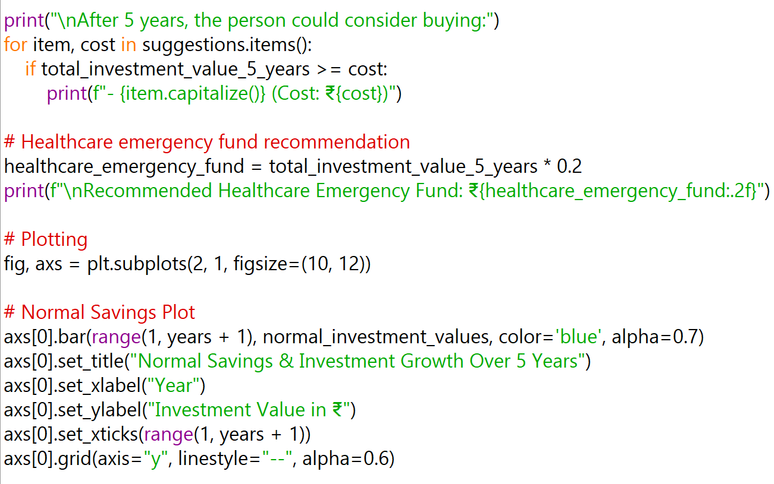

Slide 13
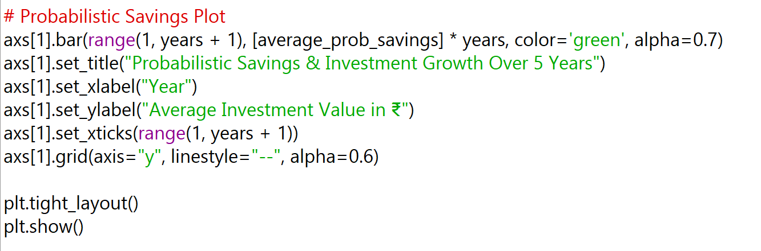


Slide 14
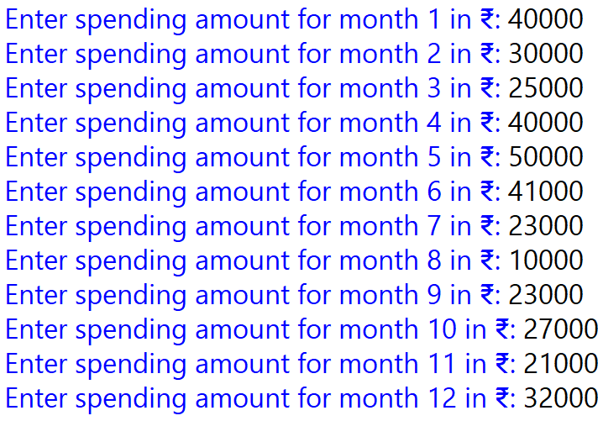

OUTPUT

Slide 15
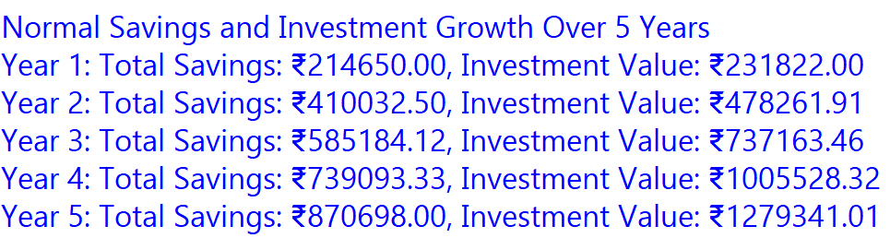
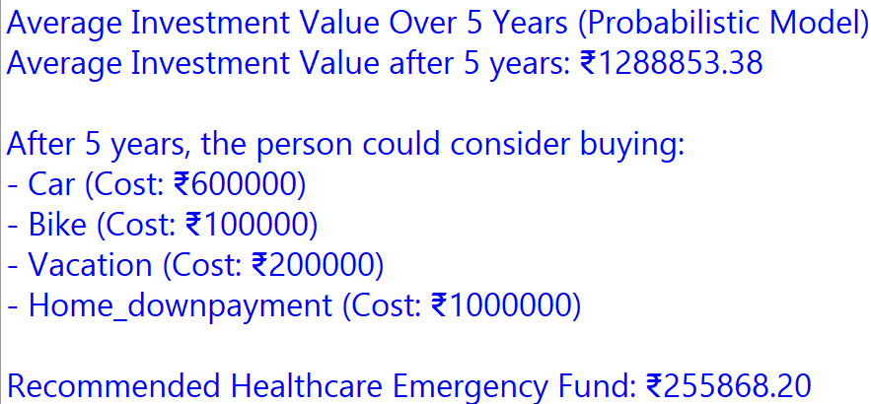


Slide 16
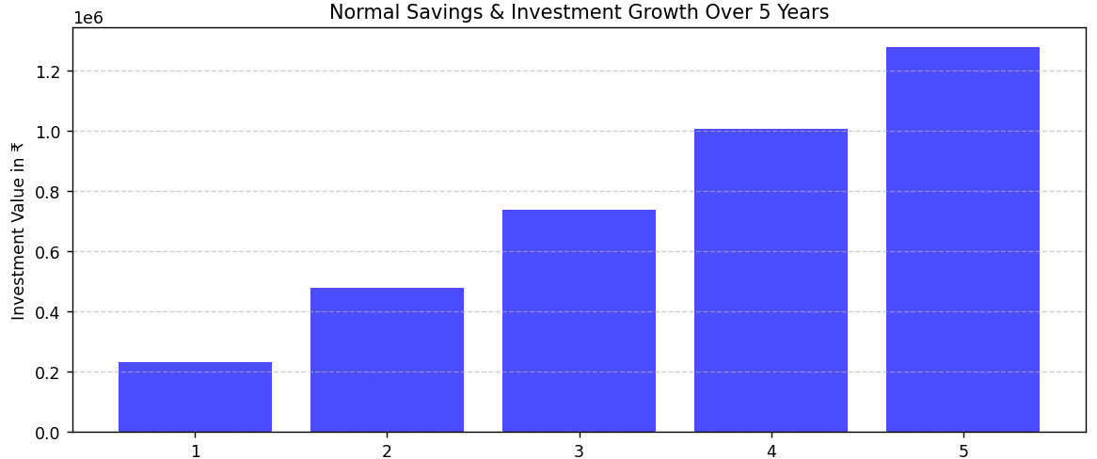
GRAPH FOR SAVING & INVESTMENT

Slide 17
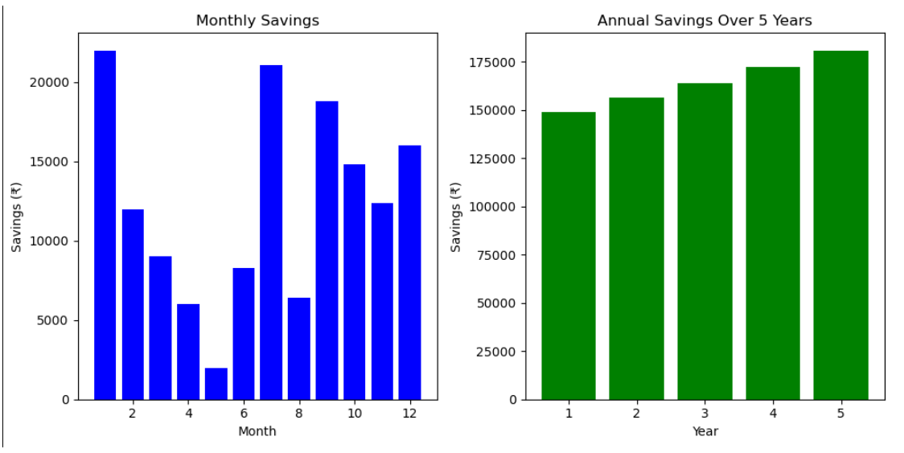
PROBABILISTIC SAVING GRAPH

Slide 18
Analysis of Results
1
Deterministic vs. Probabilistic
2
Impact of Inflation
3
Healthcare Costs
Inflation erodes purchasing power over time. The model illustrates this effect, showing that a larger amount of savings is required to maintain the same purchasing power in the future. This emphasizes the importance of considering inflation in financial planning.
Healthcare costs represent a significant expense. As healthcare costs tend to rise over time, the model underscores the need for a dedicated healthcare reserve. By factoring in potential health-related expenses, individuals can better prepare for unforeseen events.
The deterministic model provides a clear, linear path of savings growth based on fixed assumptions. However, the probabilistic model offers a more realistic view by incorporating variability and demonstrating a range of possible outcomes. This model highlights the uncertainty inherent in financial projections.

Slide 19
Conclusion
This report examined various facets of financial planning using both deterministic and probabilistic models to project potential savings and investment outcomes. While the deterministic model offered a simplified view based on fixed assumptions, the probabilistic model, incorporating variability, provided a more realistic and nuanced perspective on potential financial futures.
The findings emphasize the importance of incorporating uncertainty into financial planning and highlight the impact of inflation and healthcare costs on long-term financial health. The report stresses the need for regular savings, prudent budgeting, and periodic reviews to adapt to changing financial circumstances and ensure long-term financial well-being.

